Slide 1
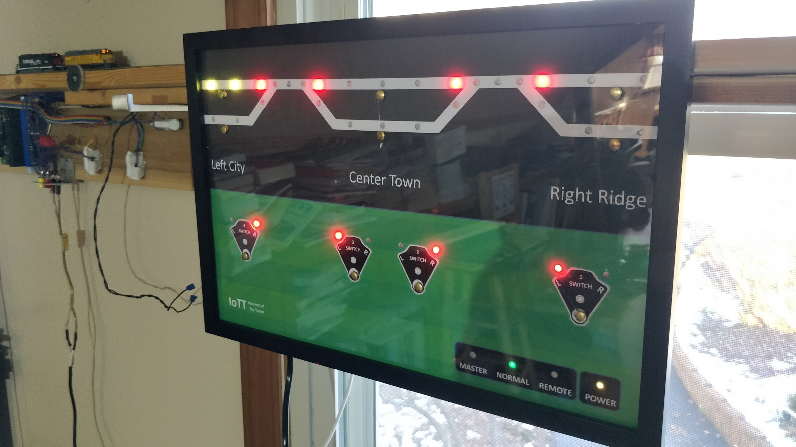
CTC Panel Configuration
&
Technology Update

Slide 2
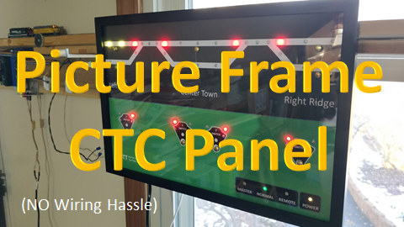
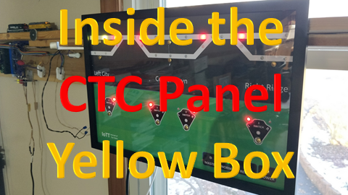
Video #9
Video #10

Slide 3
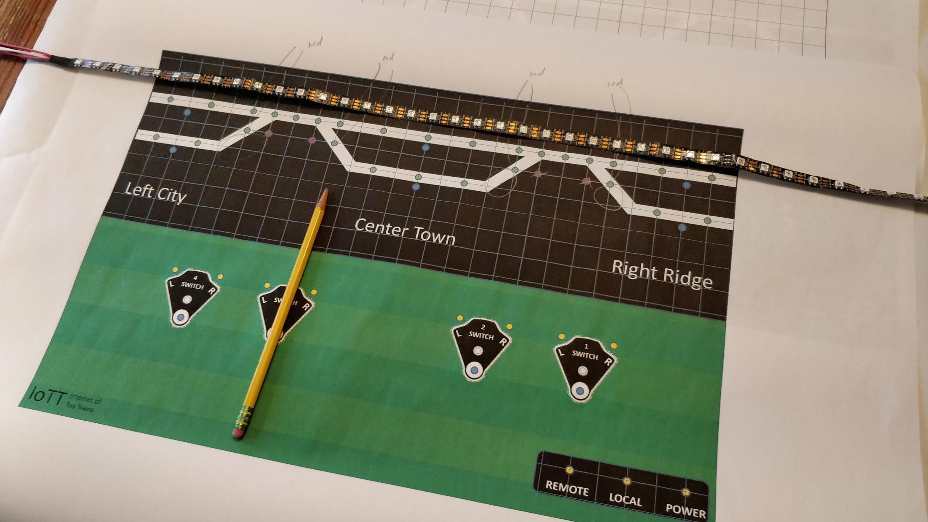

Slide 4
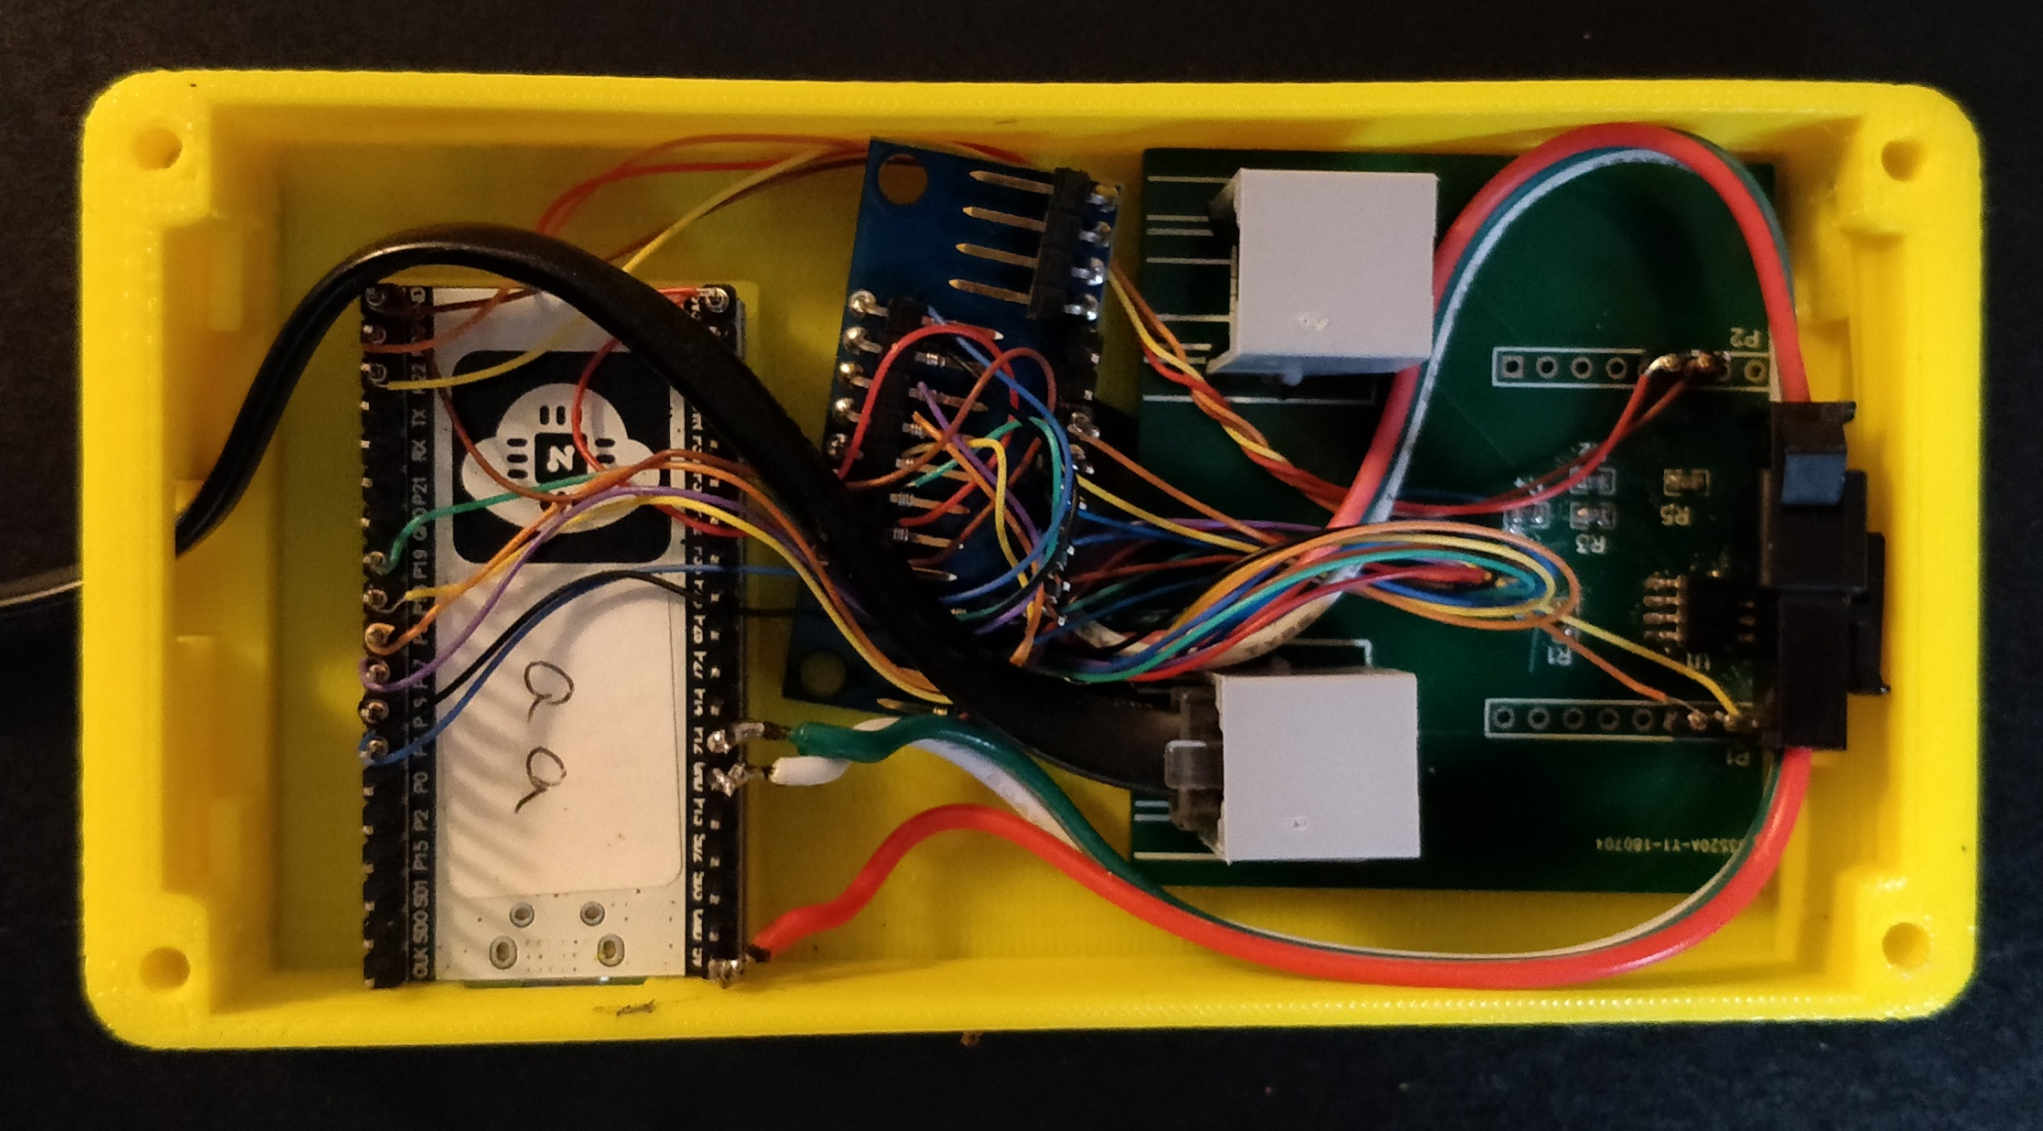
Touch Button Multiplexer
NodeMCD 32-S Controller
LocoNet Interface Board
LED Chain Connection

Slide 5
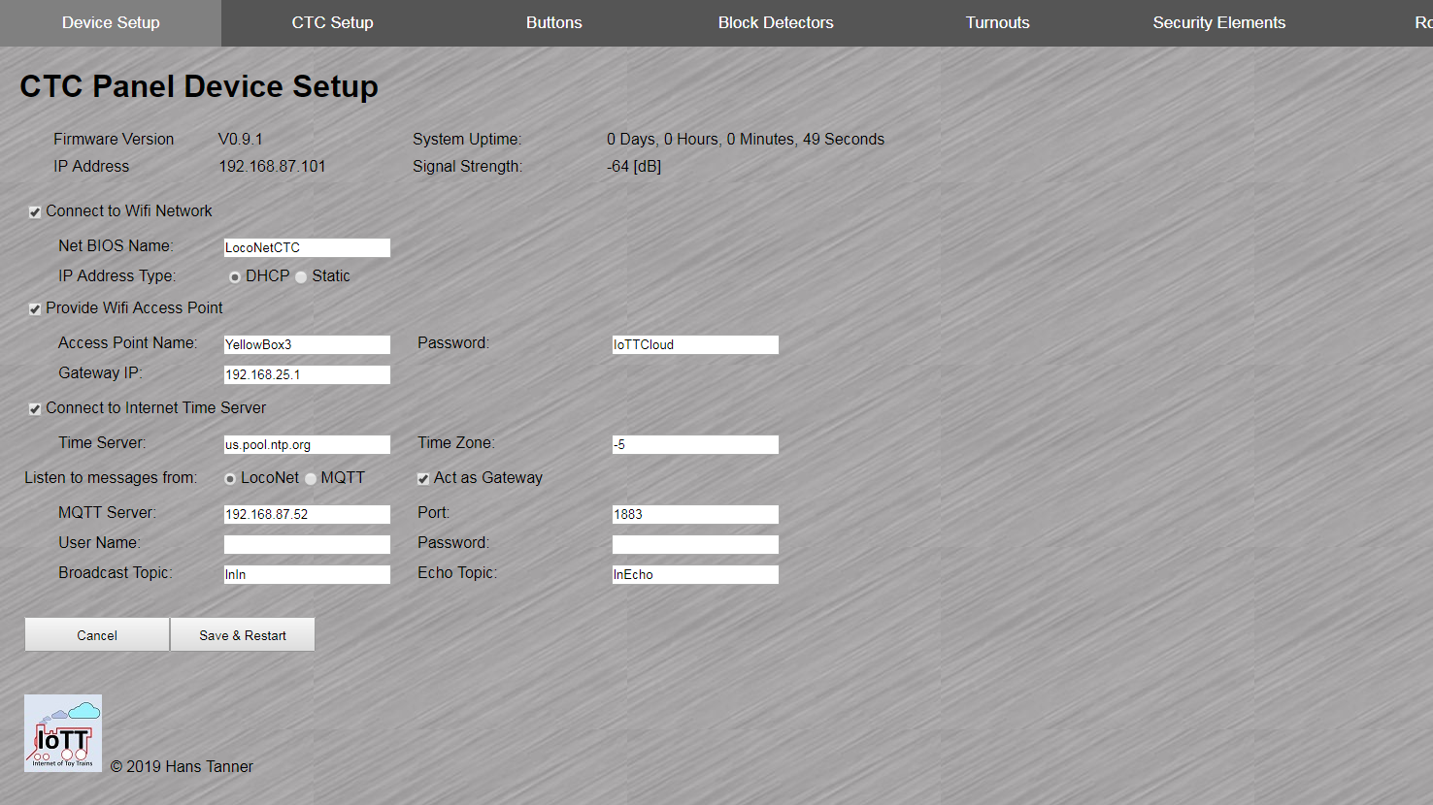

Slide 6
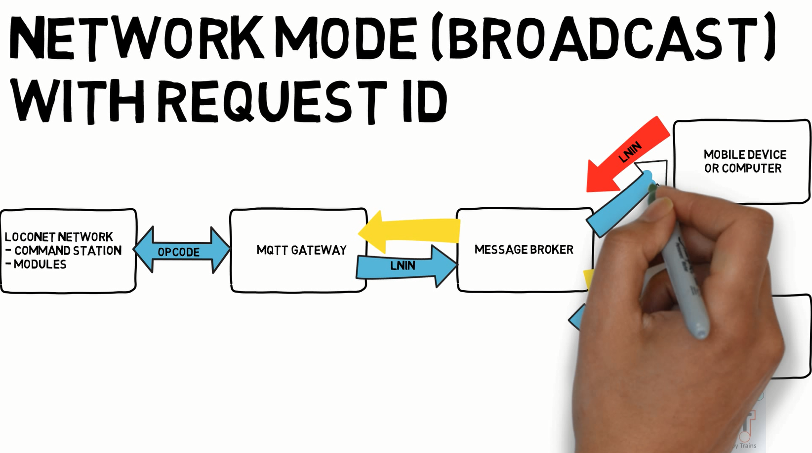

Slide 7
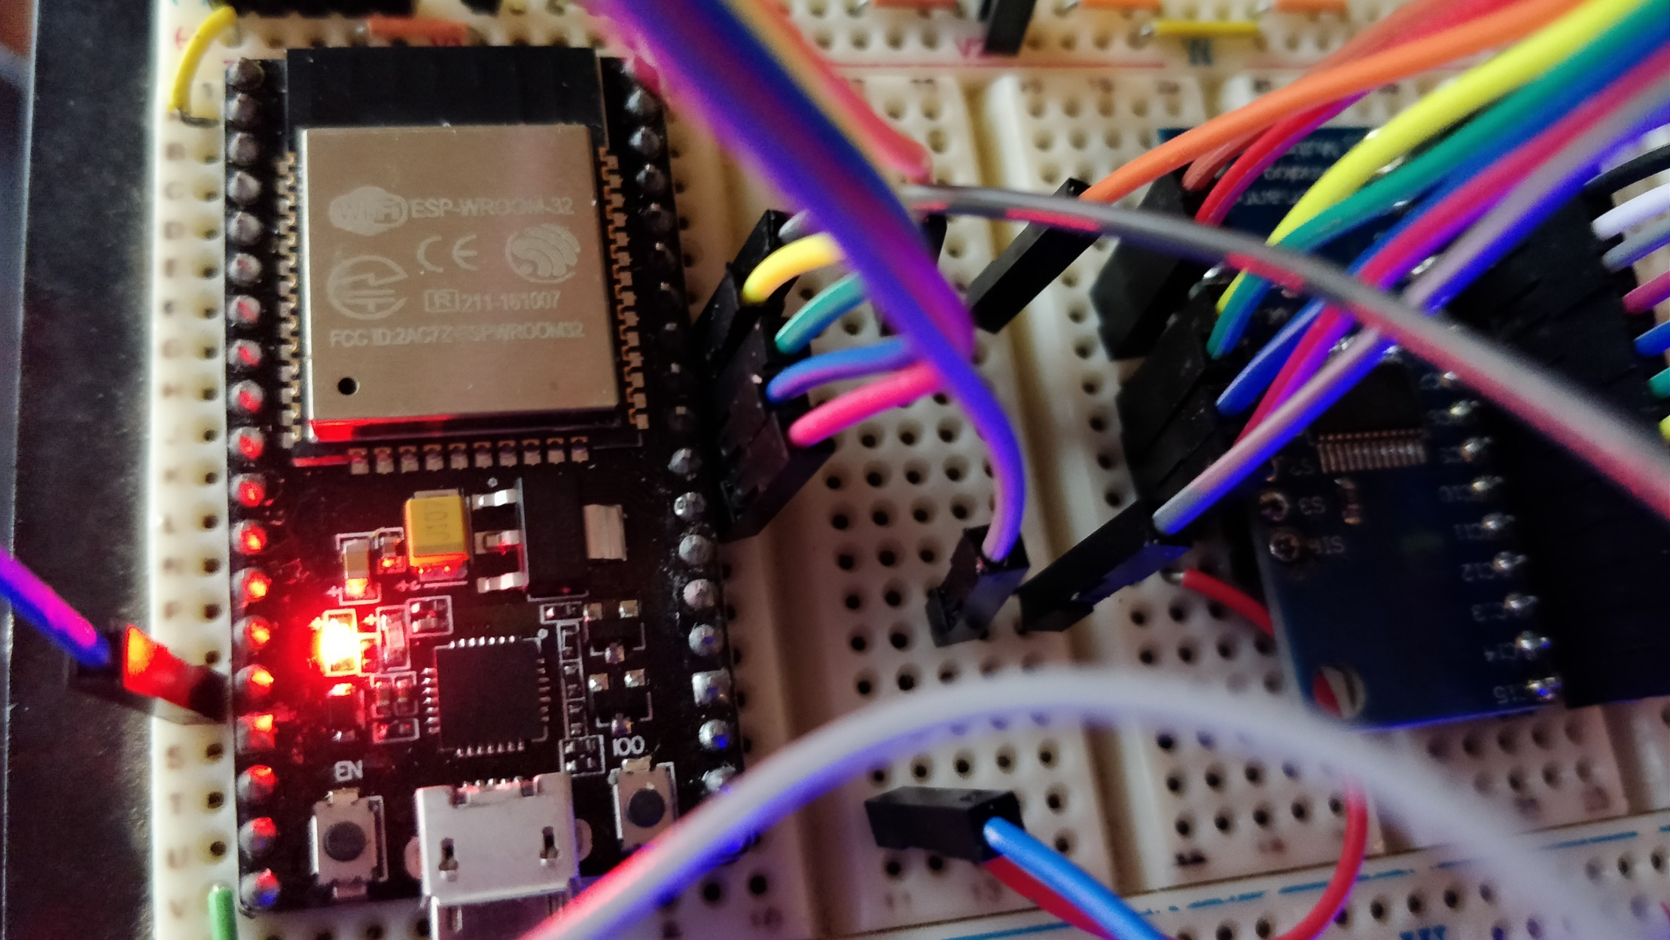

Slide 8
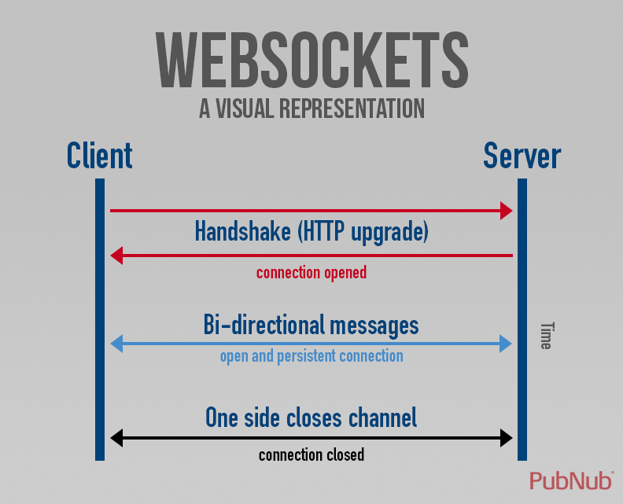

Slide 9

Table of content Min/Sec
Introduction to Configuration 0:51
CTC Panel Basic Config Demo 3:15
LocoNet to MQTT Gateway Message Update 8:45
Touch Button Auto Configuration 11:20
Websocket Communication 14:00
Summary 16:16

Slide 10
Capabilities
LED’s: Basically not limited, for sure more than what you can physically place on the CTC panel
Buttons: 64 input lines to be used as touch or digital buttons, or analog inputs
LocoNet Commands: Send Switch commands, receive Switch Position and Block Detector Messages from the LocoNet network
MQTT Commands (if connected to Wifi and MQTT broker): Same as LocoNet, plus send and receive button and status information between CTC panels for coordination and remote control
The Yellow Box can act as LocoNet to MQTT Gateway (if connected to Wifi and MQTT broker)
Wifi: Supports Access Point or Station Mode
Support of ABS and CTC control models for train movements
Supports true two button operation for selection of routes
Configuration using a web browser on a PC or Mobile Phone with Wizard support

Slide 11


Slide 12
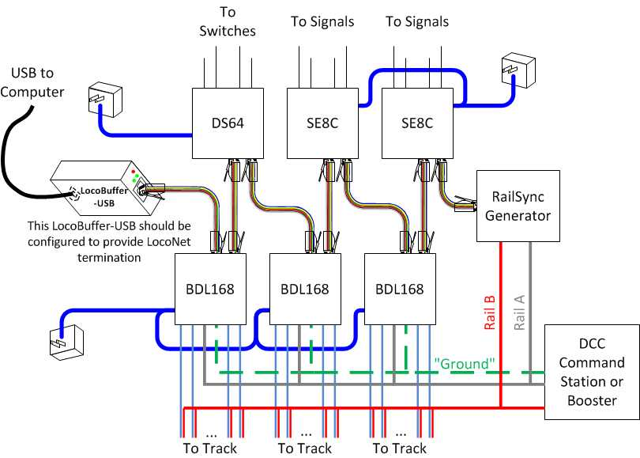
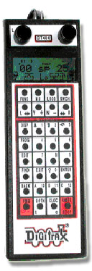
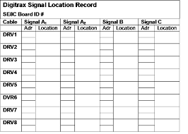
?

Slide 13


Slide 14
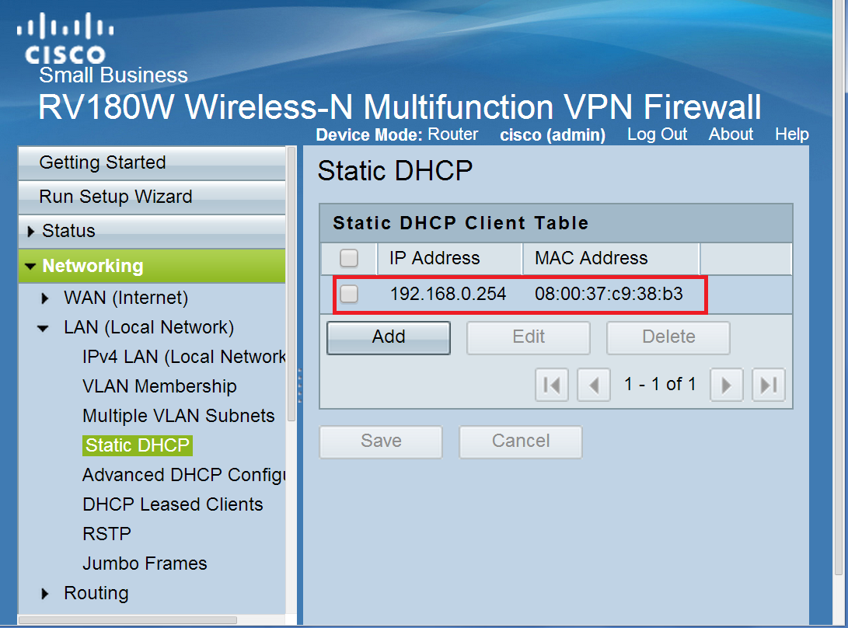
Example Router Configuration Page
Yours may look different, but has same content

Slide 15
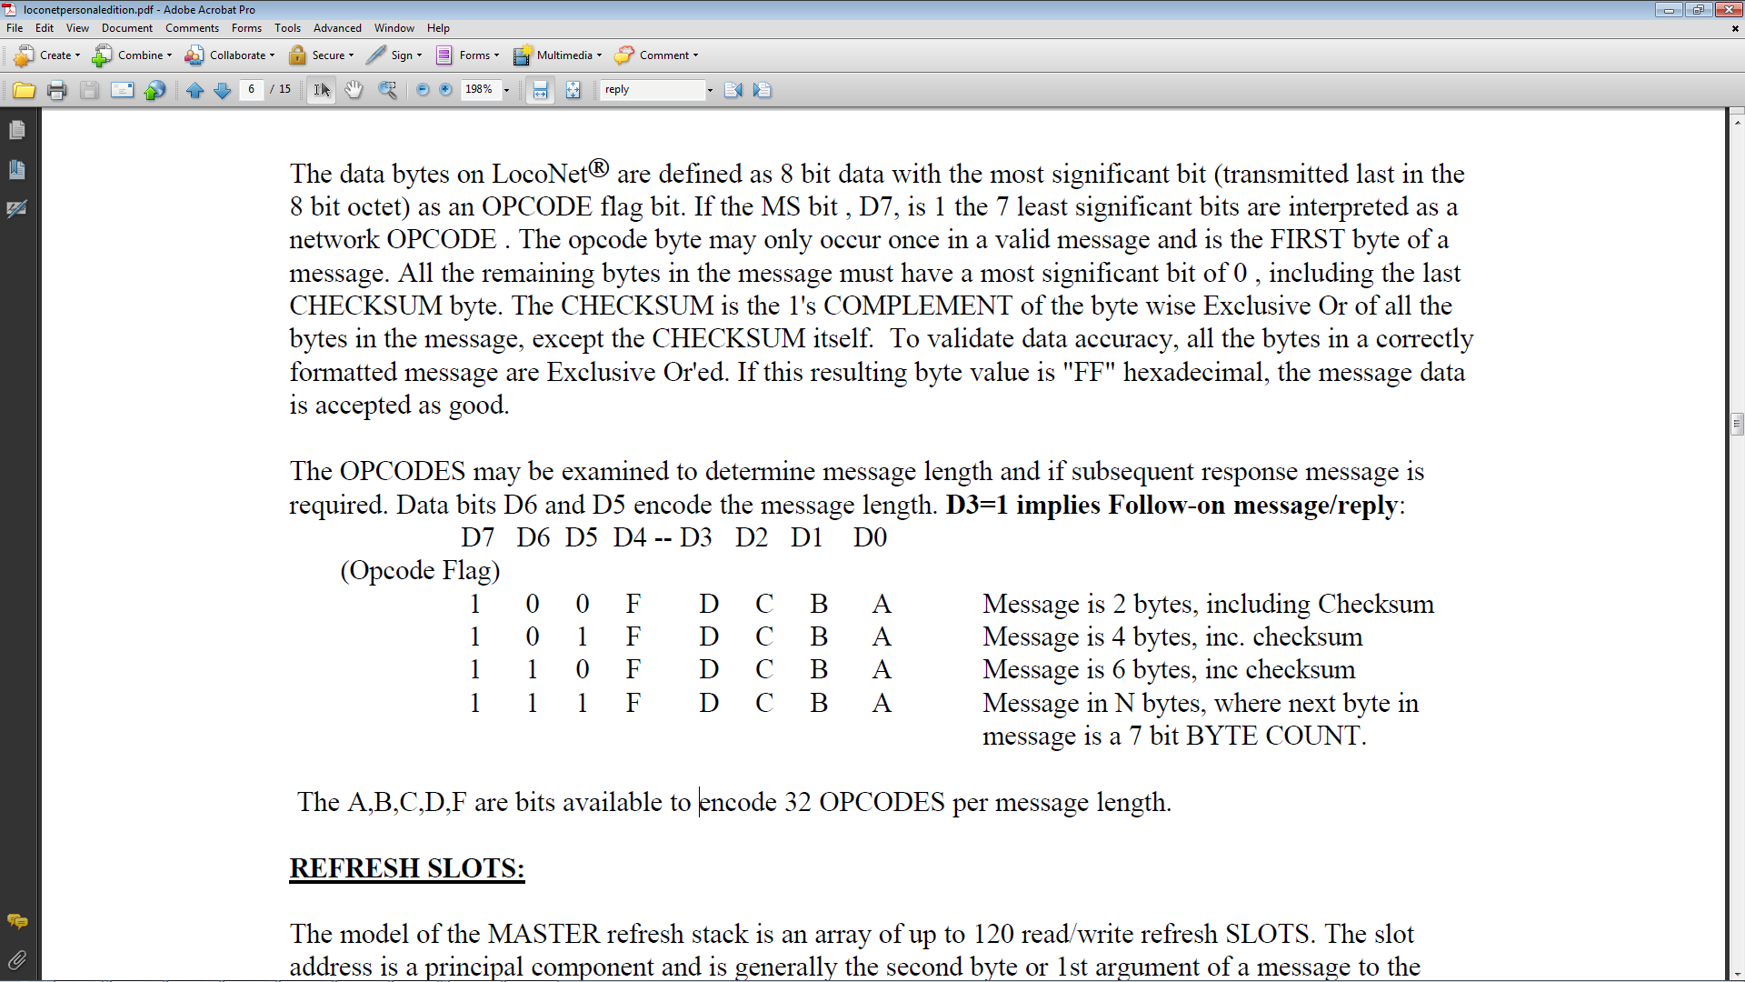
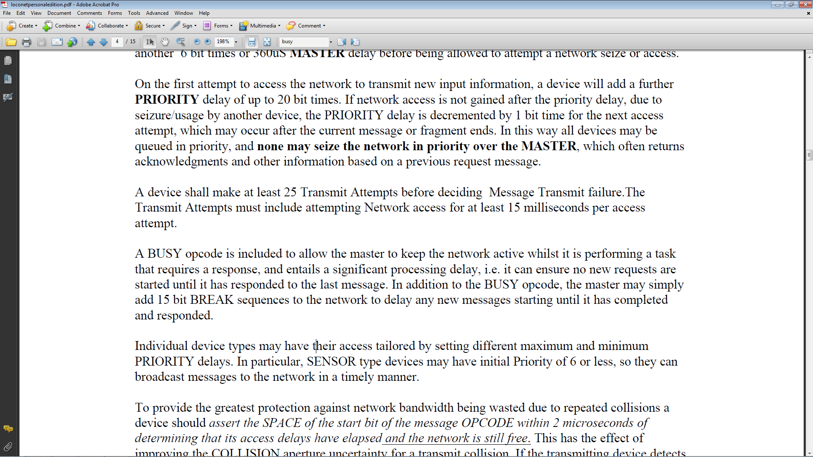

Slide 16
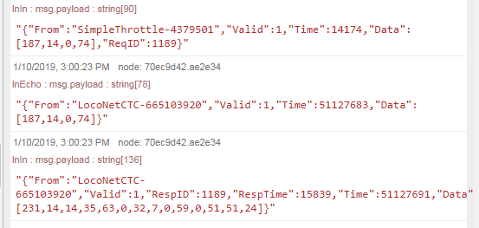
Gateway Message Flow with Response
Slot Data Request 0xBB
LocoNet Response Time in μSecs
Read Slot Data 0xE7

Slide 17
Multiplexed Touch Input Measurements on GPIO #13*
MUX Input | 0 | 1 | 2 | 3 | 4 | 5 | 6 | 7 | 8 | 9 | 10 | 11 | 12 | 13 | 14 | 15
Open Value | 16 | 16 | 16 | 16 | 16 | 16 | 16 | 16 | 16 | 16 | 16 | 16 | 16 | 16 | 16 | 16
Cable connected | 15 | 15 | 15 | 15 | 15 | 15 | 15 | 15 | 15 | 15 | 15 | 15 | 15 | 15 | 15 | 15
Touch Value | 8 | 8 | 8 | 8 | 8 | 8 | 8 | 8 | 8 | 8 | 8 | 8 | 8 | 8 | 8 | 8
* Other tested pins show almost identical results. Tested with pins 12, 13, 14, 27
Conclusions:
Very stable and repetitive behavior after MUX
Difference between touched and untouched is not much, but sufficient for reliable detection
Best results when measuring in bursts of 5 measurements and averaging the results. So far I have not seen any false positives or false negatives

Slide 18
Multiplexed Touch Input Measurements on GPIO #13*
MUX Input | 0 | 1 | 2 | 3 | 4 | 5 | 6 | 7 | 8 | 9 | 10 | 11 | 12 | 13 | 14 | 15
Open Value | 16 | 16 | 16 | 16 | 16 | 16 | 16 | 16 | 16 | 16 | 16 | 16 | 16 | 16 | 16 | 16
Cable connected | 15 | 15 | 15 | 15 | 15 | 15 | 15 | 15 | 15 | 15 | 15 | 15 | 15 | 15 | 15 | 15
Touch Value | 8 | 8 | 8 | 8 | 8 | 8 | 8 | 8 | 8 | 8 | 8 | 8 | 8 | 8 | 8 | 8
Touch Value 2** | 1 | 1 | 2 | 1 | 1 | 1 | 1 | 1 | 2 | 1 | 1 | 1 | 1 | 2 | 2 | 1
* Other tested pins show almost identical results. Tested with pins 12, 13, 14, 27
** Performing a TouchRead operation while pin is connected to a voltage source between GND and Vcc (0 – 3.3V)
Conclusions:
Very stable and repetitive behavior after MUX
Difference between touched and untouched is not much, but sufficient for reliable detection
Best results when measuring in bursts of 5 measurements and averaging the results. So far I have not seen any false positives or false negatives
When an analog signal is connected, the touchRead value is always very low, typically 1 or 2, independent of the signal voltage

Slide 19
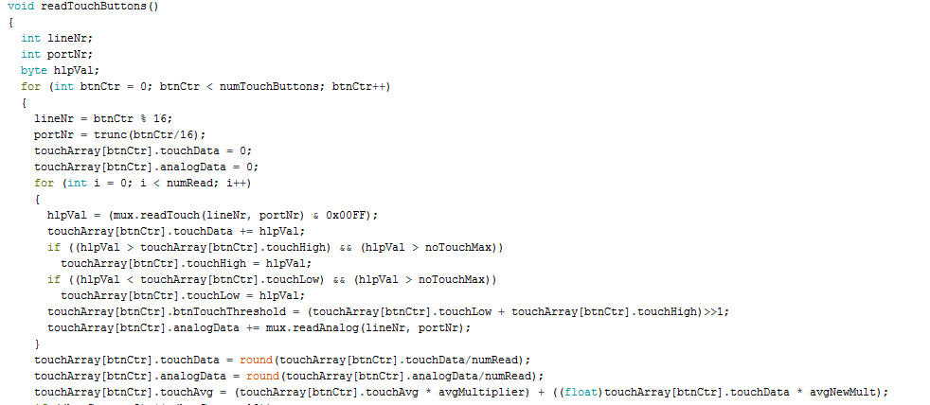
Repeat numRead=5 times for stabilized read result
Calculate average value for 5 read ops
Calculate rolling average

Slide 20
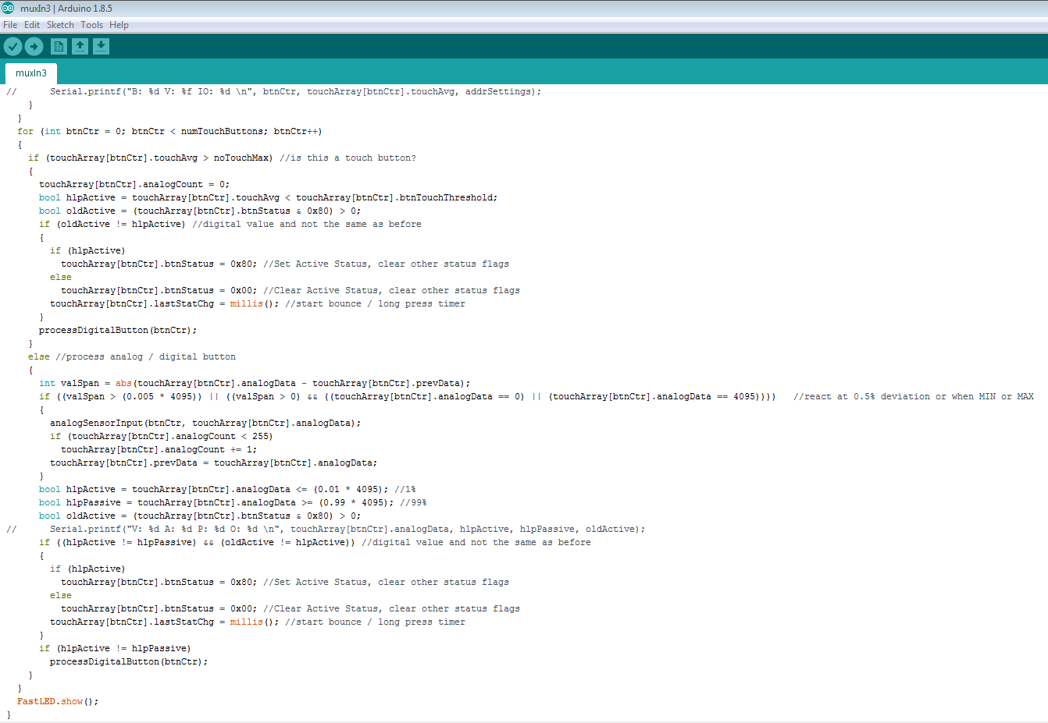
Treat data as touch input if touch value is more than 5
Otherwise evaluate analog data value. If within 1% of upper and lower limits, interpret as digital input, otherwise send analog value event

Slide 21
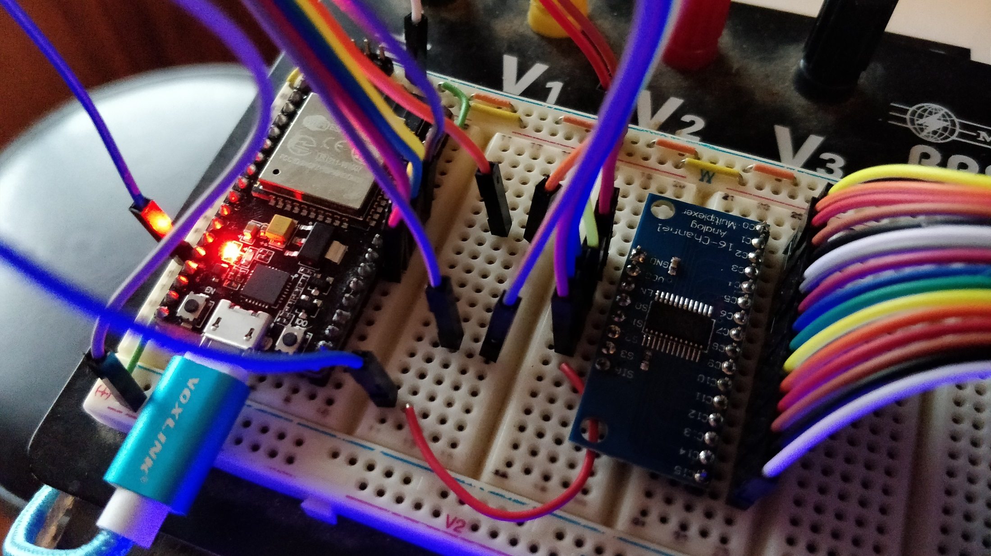
16 Input Analog MUX
16 Input Lines

Slide 22
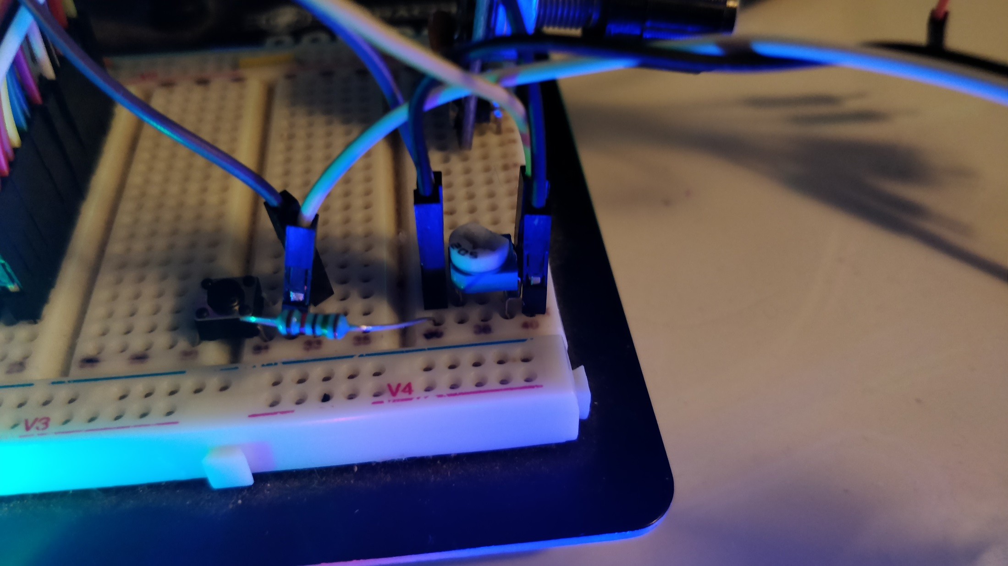
GND Wire
Input Wire
Potentiometer
GND Wire
Vcc Wire
Pullup Resistor to Vcc
Push Button (normally open)

Slide 23
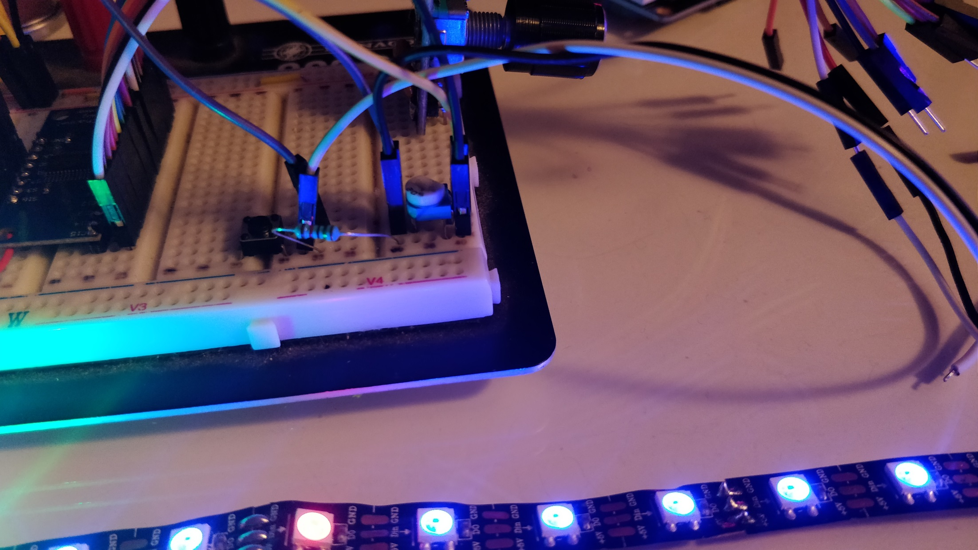

Slide 24
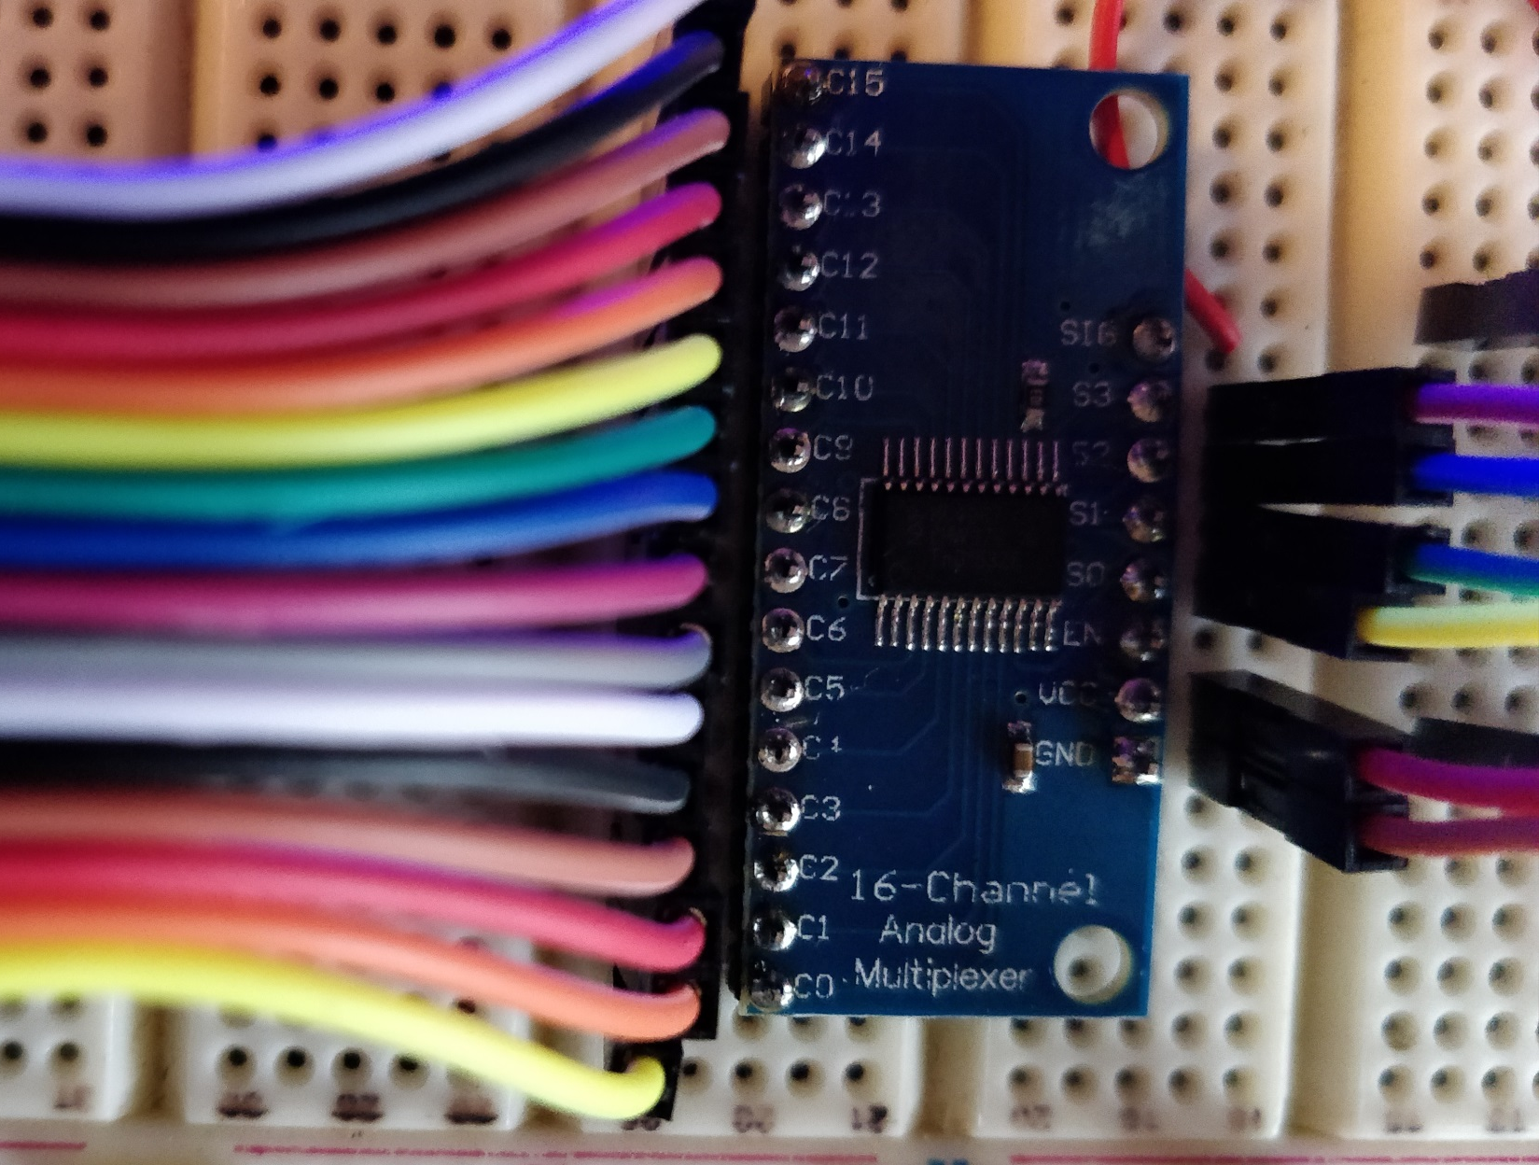

Slide 26


Slide 27


Slide 28
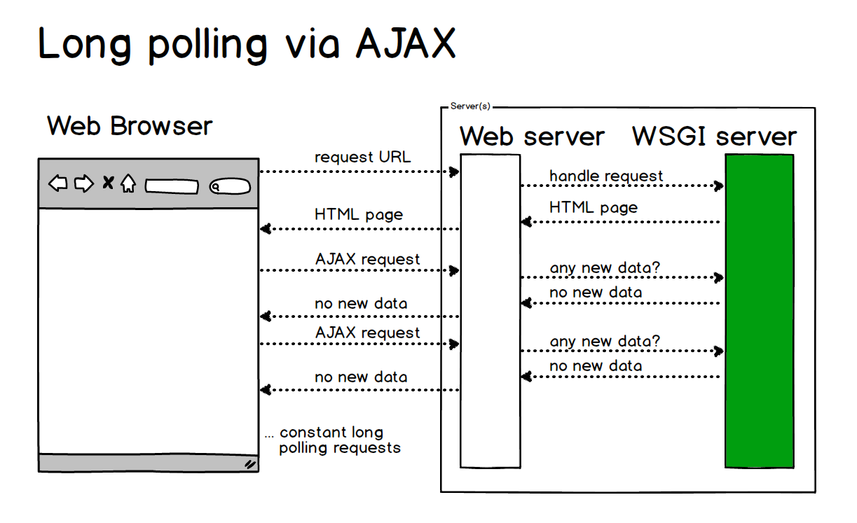

Slide 30
Summary
The Yellow Box can be configured to a wide variety of different requirements. This makes configuration very complex and a display based user dialog is almost a must
Since almost everyone has one, it makes sense to use a smart phone and a wireless connection to support device configuration
How this can work we have seen so far with the example of the general device configuration dialog
Another approach to reduce configuration complexity is making the devices smarter. Self configuring input lines is just one example
A good configuration screen also should use some Wizard technology to do the work for the user.
The use of websockets allows for continuous bidirectional communication between the device and the web browser.

Slide 31

if (watching_this(video) == (useful || interesting))
{
please_click_like();
}

Slide 32
Additional Materials on Github: https://github.com/tanner87661/IoTT-Video11
Websockets Intro: https://www.html5rocks.com/en/tutorials/websockets/basics/
Websockets Wiki: https://en.wikipedia.org/wiki/WebSocket
Layout Intro Sequence Outdoor Layout: Beat Deola, Switzerland​
Indoor Layout Videos: Hendersonville, NC Train Depot https://www.avmrc.com/​

